Slide 1

Query formulation using SELECT, WHERE, GROUP BY, HAVING and ORDER BY
Database Management System | SQL and Advanced Query Formulation
Course: Database Management System (DBMS) | Chapter: SQL and Advanced Query Formulation | Program: Bachelor of Engineering
DISCOVER · LEARN · EMPOWER
Notes:
Welcome everyone to this advanced session on SQL query formulation. We will dive deep into the core clauses that define how we extract and manipulate data. Our goal is to move beyond basic syntax to understanding the logic behind complex queries. Remember, mastering these clauses is essential for the 'Discover. Learn. Empower.' philosophy of our engineering program.

Slide 2
Course Outcomes
SLIDE 2 / 14
Course Outcome
CO | BT LEVEL | DESCRIPTION
CO1 | BT2 | Explain database architecture, relational model concepts and formal query language foundations including relational algebra and relational calculus.
CO2 | BT3 | Apply relational algebra, relational calculus and SQL constructs to formulate correct and efficient database queries.
CO3 | BT4 | Analyze functional dependencies and design normalized relational schemas up to 5NF ensuring lossless join and dependency preservation.
CO4 | BT4 | Analyze transaction schedules and concurrency control mechanisms to determine serializability, recoverability and correctness.
CO5 | BT5 | Evaluate storage structures, indexing strategies and query optimization techniques for performance, scalability and reliability.
Chandigarh University
2 / 14
Notes:
This lecture directly addresses CO1 by reinforcing the formal foundations of relational algebra through SQL syntax. It also supports CO5 because understanding query structure is the first step in evaluating optimization strategies. We will see how the order of clauses impacts the execution plan and overall system performance. These outcomes ensure you can both explain and evaluate database behaviors effectively.

Slide 3
Learning Objectives
SLIDE 3 / 14
Learning Outcomes
1
Analyze the logical execution order of SQL clauses versus their syntactic writing order.
2
Construct complex queries using GROUP BY and HAVING to filter aggregated results.
3
Differentiate between WHERE and HAVING filters based on the timing of execution.
4
Evaluate the impact of ORDER BY on result set presentation and performance.
5
Synthesize multi-clause queries to solve real-world data analysis problems efficiently.
Chandigarh University
3 / 14
Notes:
By the end of this session, you will be able to analyze why SQL executes in a specific logical order. You will learn to construct queries that filter groups of data, not just individual rows. We will differentiate clearly between row-level and group-level filtering to avoid common logical errors. Finally, you will synthesize these skills to solve complex data analysis problems efficiently.

Slide 4

Lecture
SLIDE 4 / 14
Logical Execution Order of SQL Clauses
THE LOGICAL SEQUENCE IS
FROM → WHERE → GROUP BY → HAVING → SELECT → ORDER BY.
• SQL is written in one order but executed in a specific logical sequence.
• The database engine processes FROM and JOIN before any filtering occurs.
• WHERE filters rows before grouping, while HAVING filters groups after aggregation.
• GROUP BY aggregates rows into summary groups based on specified columns.
• SELECT and ORDER BY are processed last to format the final output.
• Understanding this order prevents logical errors in complex query formulation.
Linear Diagram Represents Six Stage Process Flow Chart Template Powerpoint Slides | Graphics Presentation | Background for PowerPoint | PPT
Chandigarh University
4 / 14
Notes:
Many students write queries in the order they think, but the database executes them differently. The engine first identifies the tables, then filters rows, then groups them, and finally sorts the results. For example, if you try to filter on an aggregate function in the WHERE clause, the query will fail because that column doesn't exist yet. Always remember: filtering happens before grouping, and sorting happens after everything else.

Slide 5
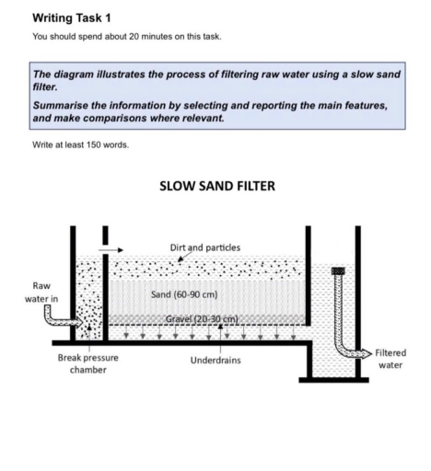
Lecture
SLIDE 5 / 14
The WHERE Clause for Row-Level Filtering
EXAMPLE
WHERE salary > 50000 selects only high-earning employees immediately.
• The WHERE clause filters individual rows before any aggregation or grouping occurs.
• It uses conditions like equality, comparison, or logical operators to select rows.
• Conditions in WHERE must reference existing column values, not aggregate functions.
• Using WHERE reduces the dataset size early, improving query performance significantly.
• It cannot be used to filter results based on calculated group totals.
• The database evaluates the WHERE condition for every row in the source table.
Source: engnovatewebsitestorage.blob.core.windows.net
Chandigarh University
5 / 14
Notes:
Think of the WHERE clause as a sieve that removes unwanted rows before they are processed further. It operates on individual records, so you cannot use it to check if a group average meets a criteria. For instance, you can filter for employees earning more than 50,000, but you cannot filter for departments with an average salary above 50,000 using WHERE. This distinction is crucial for writing correct and efficient queries.

Slide 6
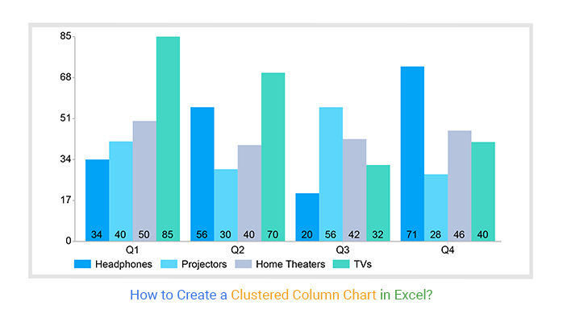
Lecture
SLIDE 6 / 14
The GROUP BY Clause for Aggregation
EXAMPLE
GROUP BY department_id creates one row for each unique department.
• GROUP BY organizes rows into groups based on unique values in specified columns.
• It enables the use of aggregate functions like SUM, AVG, COUNT, MAX, and MIN.
• Every column in the SELECT list must be either aggregated or in GROUP BY.
• The clause collapses multiple rows into a single summary row per group.
• It transforms a flat table into a summarized view for analytical reporting.
• The order of columns in GROUP BY determines the grouping hierarchy.
Source: chartexpo.com
Chandigarh University
6 / 14
Notes:
The GROUP BY clause is the engine of data summarization in SQL. It takes a large set of rows and collapses them into groups based on a key column. For example, if you group by department, you get one row per department with aggregated data. Remember, if you select a column that is not in the GROUP BY clause, it must be inside an aggregate function, or the query will fail. This rule ensures data consistency in your results.

Slide 7
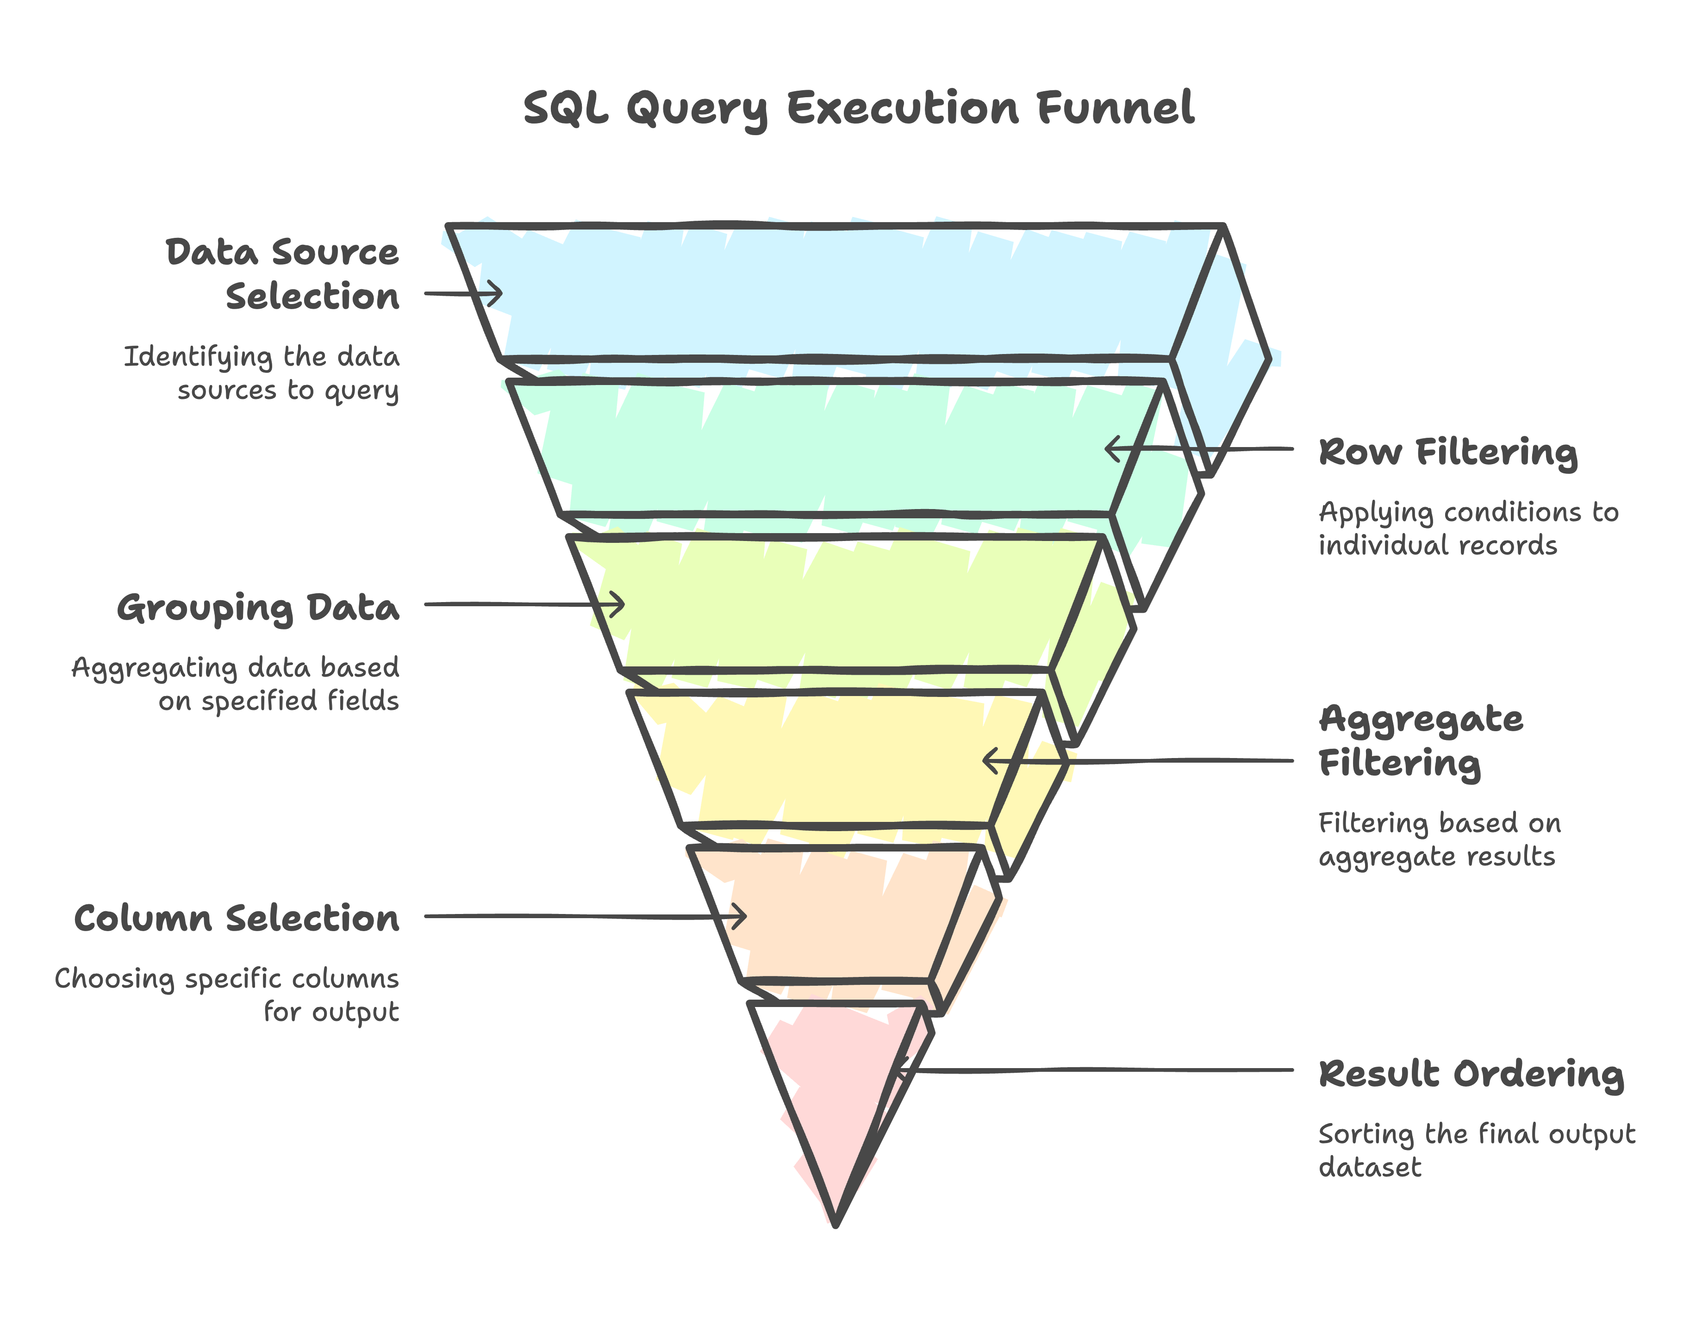
Lecture
SLIDE 7 / 14
The HAVING Clause for Group Filtering
EXAMPLE
HAVING COUNT(*) > 5 selects departments with more than five employees.
• The HAVING clause filters groups after the GROUP BY aggregation is complete.
• It allows conditions on aggregate functions like AVG(salary) > 50000.
• HAVING is the only place to filter based on calculated group totals.
• It works similarly to WHERE but operates on the result of grouping.
• Using HAVING without GROUP BY treats the entire table as a single group.
• It is essential for finding groups that meet specific statistical criteria.
Source: static-assets.codecademy.com
Chandigarh University
7 / 14
Notes:
While WHERE filters rows, HAVING filters groups. This is the critical difference you must master. You use HAVING when you need to check a condition on an aggregate value, such as finding departments where the average salary exceeds a certain threshold. If you try to use an aggregate function in a WHERE clause, the database will throw an error because the aggregation hasn't happened yet. Always place HAVING after GROUP BY in your logical flow.

Slide 8
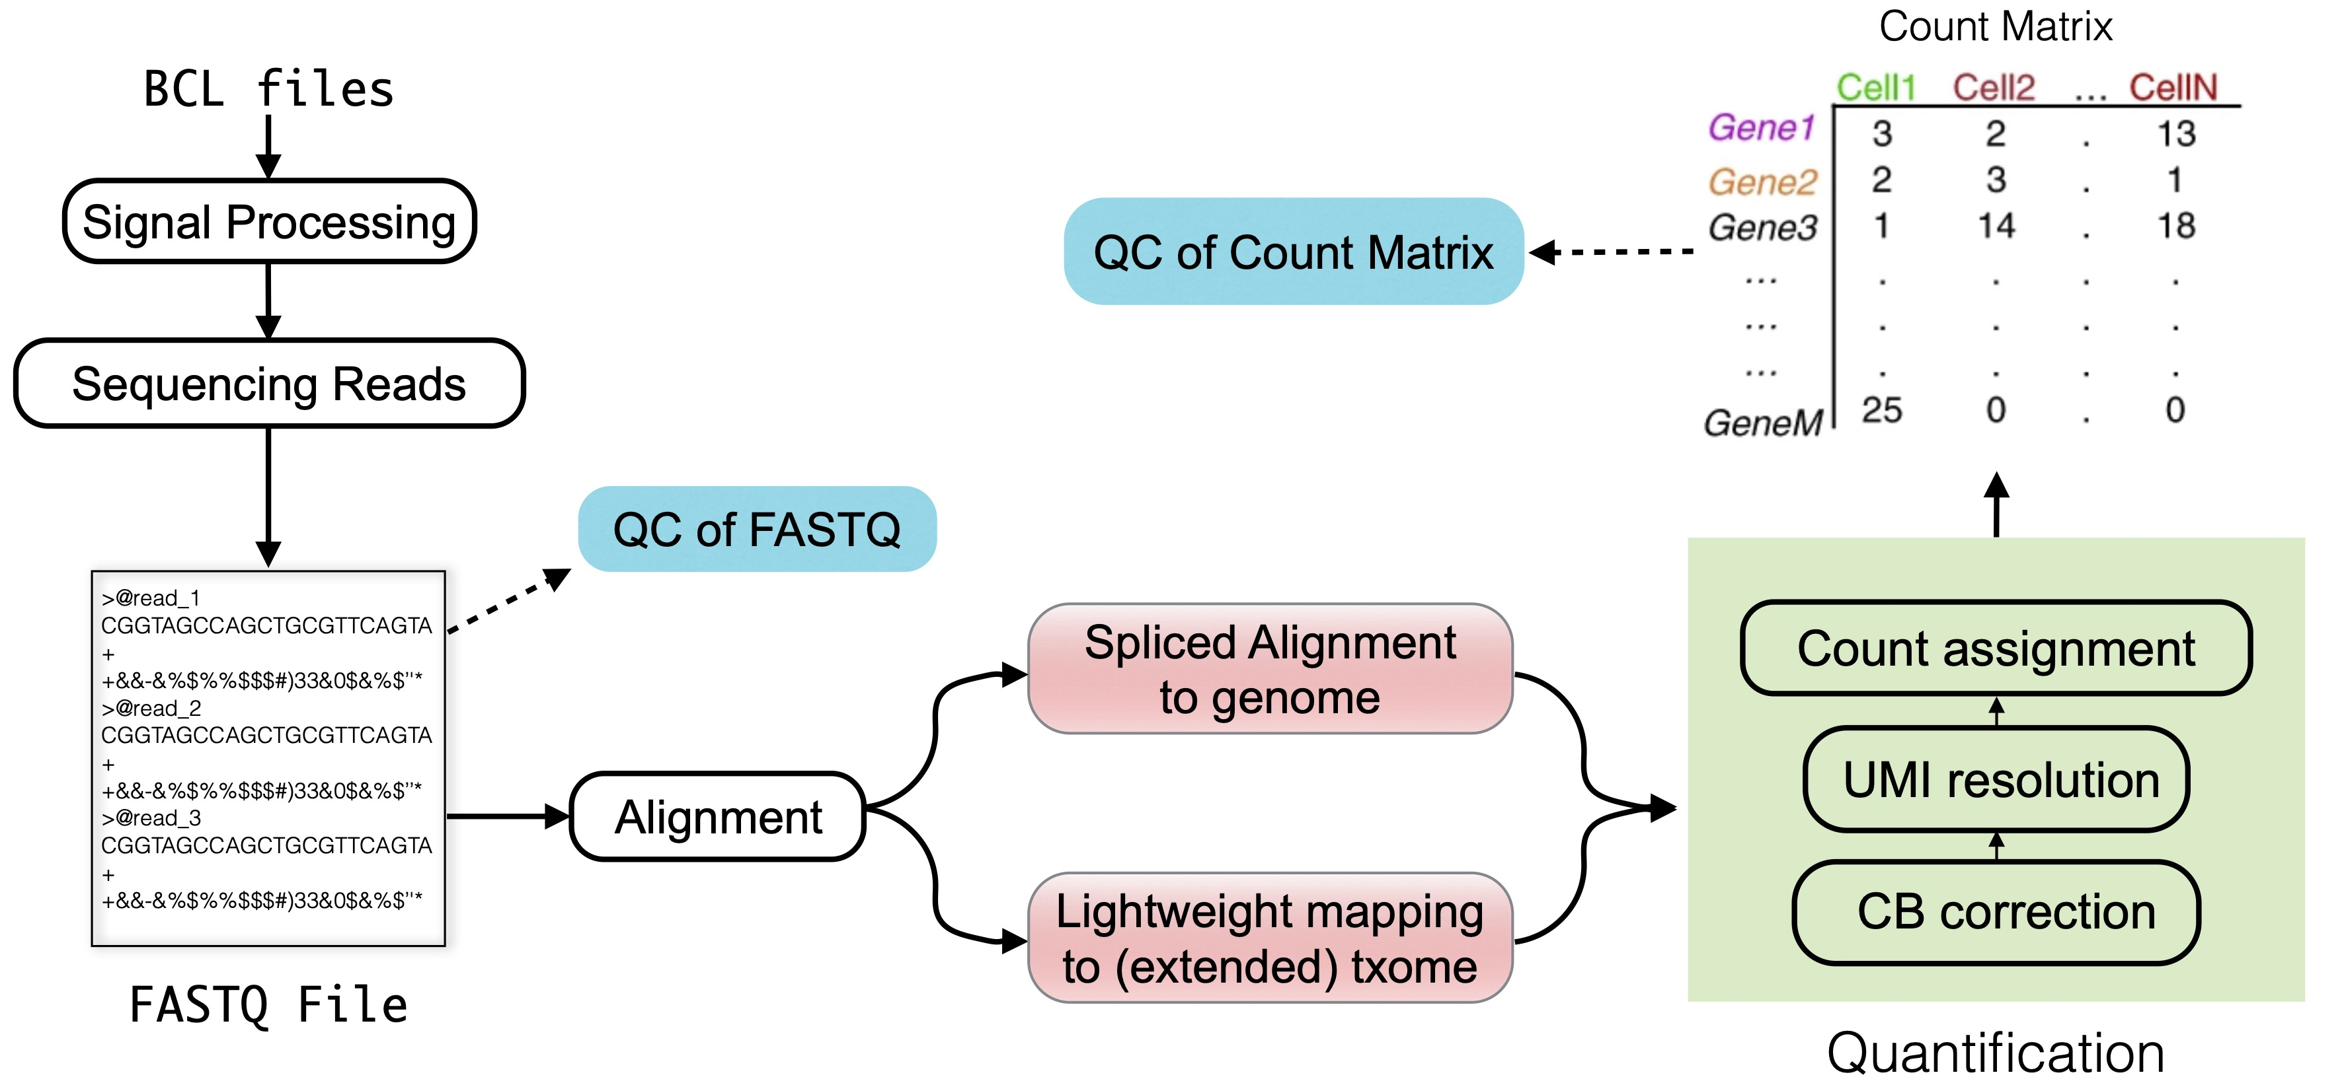
Worked Example
SLIDE 8 / 14
Sales Analysis Query
SCENARIO
Find departments with total sales over 100,000 and average sales > 5,000.
QUERY
SELECT dept, SUM(sales), AVG(sales) FROM Sales GROUP BY dept HAVING SUM(sales) > 100000 AND AVG(sales) > 5000.
STEP 1
FROM identifies the Sales table as the source of data.
STEP 2
GROUP BY organizes rows by unique department identifiers.
STEP 3
Aggregates calculate SUM and AVG for each department group.
STEP 4
HAVING filters out departments failing the total or average criteria.
STEP 5
SELECT formats the final output showing only qualifying departments.
Source: www.sc-best-practices.org
Chandigarh University
8 / 14
Notes:
Let's walk through a concrete example to see this in action. Imagine we have a Sales table with thousands of transactions. We want to find departments that are performing well, defined by total sales over 100,000 and an average sale above 5,000. The database first groups the data by department, calculates the totals, and then applies the HAVING clause to filter the results. This ensures we only see the high-performing departments in our final report.

Slide 9
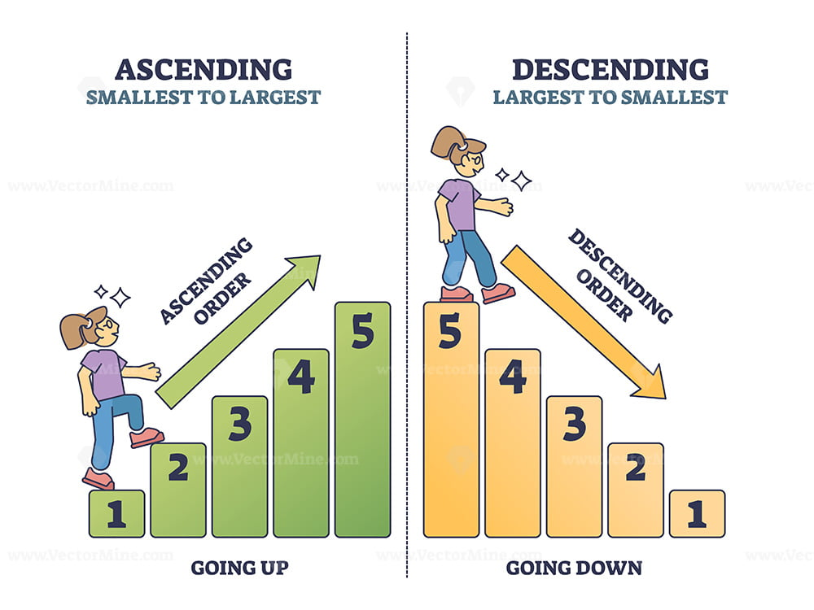
Lecture
SLIDE 9 / 14
The ORDER BY Clause for Result Sorting
EXAMPLE
ORDER BY total_sales DESC lists departments from highest to lowest sales.
• ORDER BY sorts the final result set based on one or more columns.
• It can sort by column names, aliases, or positional numbers (1, 2, etc.).
• Default sort order is ascending (ASC); use DESC for descending order.
• ORDER BY is processed after all filtering and grouping is complete.
• It does not affect the logical grouping but changes the visual presentation.
• Excessive sorting on large datasets can impact query performance significantly.
Source: bunny-wp-pullzone-lcnorhfy96.b-cdn.net
Chandigarh University
9 / 14
Notes:
Once your data is filtered and aggregated, ORDER BY arranges it for human readability. You can sort by any column in your result set, including calculated aggregates. By default, the sort is ascending, but you can explicitly request descending order using the DESC keyword. Remember, this is the very last step in the logical execution order, so it does not influence which rows are selected, only how they appear.

Slide 10

Common Pitfall
SLIDE 10 / 14
WHERE vs HAVING Confusion
ERROR
Using WHERE with aggregate functions causes a syntax or logical error.
ERROR
Using HAVING without GROUP BY filters the entire table as one group.
ERROR
Selecting non-aggregated columns not in GROUP BY violates SQL standards.
PITFALL
Filtering on an alias defined in SELECT often fails in older SQL versions.
CORRECTION
Move aggregate conditions from WHERE to HAVING for correct logic.
CORRECTION
Ensure all non-aggregated columns are included in the GROUP BY clause.
• Understanding the execution order prevents these frequent formulation mistakes.
Source: static.vecteezy.com
Chandigarh University
10 / 14
Notes:
The most common mistake students make is trying to filter on an aggregate function using the WHERE clause. For example, writing WHERE AVG(salary) > 50000 will fail because the average doesn't exist yet. You must move that condition to the HAVING clause. Another pitfall is selecting a column that isn't in the GROUP BY clause without aggregating it. Always check your logical flow to ensure you are filtering at the right stage of execution.

Slide 11
Lecture
SLIDE 11 / 14
Performance Implications of Clause Order
1
Early filtering with WHERE reduces the dataset size before expensive grouping.
2
Indexing columns in WHERE and GROUP BY clauses improves query speed.
3
Sorting large result sets with ORDER BY can be computationally expensive.
4
The database optimizer reorders clauses internally for the most efficient execution.
5
Writing clear logic helps the optimizer generate better execution plans.
6
Avoid unnecessary sorting if the result order does not matter for the user.
7
Proper clause usage aligns with CO5 goals of performance and scalability.
Chandigarh University
11 / 14
Notes:
From a performance perspective, the order in which you write your query matters less than the logical flow the optimizer follows. However, using WHERE to filter early is always better than filtering late. If you filter 90% of the rows before grouping, the aggregation step becomes much faster. This aligns with our course outcome on evaluating optimization techniques. Always consider how your query structure impacts the database engine's workload.

Slide 12
Advanced
SLIDE 12 / 14
Nested Aggregates and Subqueries
EXAMPLE
Find departments where average salary exceeds the company-wide average.
• Complex queries may require nested GROUP BY or subqueries for multi-level analysis.
• Subqueries can provide dynamic values for HAVING conditions in outer queries.
• The inner query calculates the global average, while the outer query filters groups.
• Nested aggregates require careful handling of column aliases and scopes.
• This approach allows for comparative analysis across different data hierarchies.
• Ensure subqueries return a single value when used in HAVING conditions.
Chandigarh University
12 / 14
Notes:
Sometimes a simple GROUP BY is not enough. You might need to compare a department's average salary against the company-wide average. This requires a subquery to calculate the global average first. The outer query then groups by department and uses HAVING to compare each group against that global value. This technique allows for sophisticated comparative analysis, which is a key skill in advanced query formulation.

Slide 13
Lecture
SLIDE 13 / 14
Key Takeaways
SQL EXECUTES IN A SPECIFIC LOGICAL ORDER
FROM → WHERE → GROUP BY → HAVING → SELECT → ORDER BY.
• WHERE filters individual rows before grouping, while HAVING filters groups after aggregation.
• Aggregate functions like SUM and AVG can only be filtered using the HAVING clause.
• ORDER BY sorts the final result set and is processed last in the logical sequence.
• Understanding clause interactions prevents logical errors and improves query performance.
Chandigarh University
13 / 14
Notes:
To summarize, always remember the logical execution order of SQL clauses. This order dictates where you can use specific filters and functions. Use WHERE for row-level filtering and HAVING for group-level filtering. Finally, ORDER BY is your tool for presenting the final data in a useful way. Mastering these distinctions is the foundation of advanced SQL query formulation.

Slide 14
Lecture
SLIDE 14 / 14
References
1
Fundamentals of Database Systems — Ramez Elmasri & Shamkant B. Navathe
2
Database System Concepts — Silberschatz, Korth & Sudarshan
3
Database Management Systems — Raghu Ramakrishnan & Johannes Gehrke
4
Oracle/MySQL Documentation — Oracle
Chandigarh University
14 / 14
Notes:
For further reading and deeper understanding of these concepts, please refer to the standard textbooks listed here. Elmasri and Navathe provide excellent coverage of relational algebra foundations. Silberschatz offers a comprehensive view of database systems, while Ramakrishnan provides practical insights into query processing. Finally, the Oracle and MySQL documentation are invaluable resources for specific syntax and optimization features. Thank you for your attention.

